Slide 1
BRIC Power Emerging Countries: Brazil, Russia, India, China and Dell Strategy
Peter Macejka, Alexandra Vančová

Slide 2


About presenters
Peter
Macejka
Education:
Masters in Trade & Marketing
University of Economics Bratislava
Work experience Dell:
Emerging Distribution Finance Director (1 Yr)
Emerging Commercial FP&A Manager (3.5Yrs)
Finance Consultant (0.5 Yrs)
Project Manager (1.5 Yrs)
Servicing Pricing Lead (1.5 Yr)
Alexandra
Vančová
Education:
Masters in Maths & Mgmt, Comenius University, 2002
PhD in Mathematics, Comenius University
Work experience Dell:
Services FP&A manager (0.25 Yr)
MLP Western FP&A team member (0.75 Yr)
PLE EMEA RUM Forecast Coordinator (1 Yr)
LE EMEA OPEX controlling (0.75 Yr)
EMEA Fin Systems Training Coordinator (1Yr)
OPEX controlling - Central OPEX team (2 Yr)

Slide 3
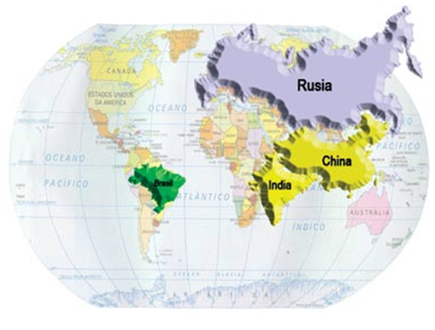
Agenda Brazil, Russia, India, China and DELL strategy
Global Economy – Emerging vs. Advanced
Overview of BRIC countries – what BRIC means
Brazil – IT Market overview, Dell Approach
China – IT Market overview, Dell Approach
India – IT Market overview, Dell Approach
Russia – Weaknesses / IT Market overview
Class activity
Key takeaways

Slide 4
Global economy

Slide 5
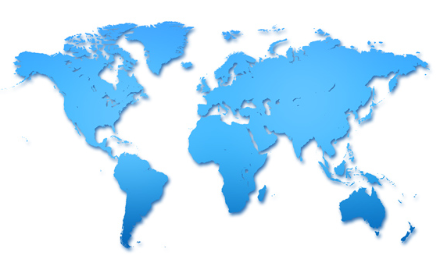
Global economy - 1950
1950, share of world GDP
56.8 %
43.2 %
Developed Markets
Emerging Markets
Confidential

Slide 6
Global economy - 2030
2030, share of world GDP
32.8 %
67.2 %
Developed Markets
Emerging Markets
Source: IMF
Confidential

Slide 7
Top 10 | GDP ranking (in USD)
 | 1995 | 2000 | 2005 | 2010 | 2015
1 | United States | United States | United States | United States | United States
2 | Japan | Japan | Japan | China | China
3 | Germany | Germany | Germany | Japan | Japan
4 | France | United Kingdom | United Kingdom | Germany | Germany
5 | United Kingdom | France | China | France | Brazil
6 | Italy | China | France | United Kingdom | United Kingdom
7 | Brazil | Italy | Italy | Brazil | France
8 | China | Canada | Canada | Italy | India
9 | Spain | Brazil | Spain | India | Russia
10 | Canada | Mexico | Brazil | Canada | Italy
Confidential

Slide 8
Average GDP growth 2010 - 2017
Source: IMF

Slide 9
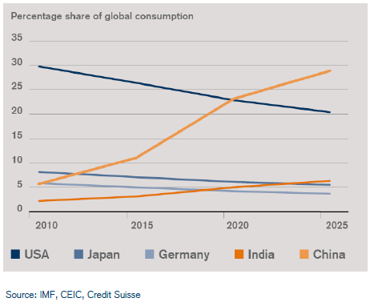
Consumption shifts to emerging markets

Slide 10
BRIC Countries

Slide 11

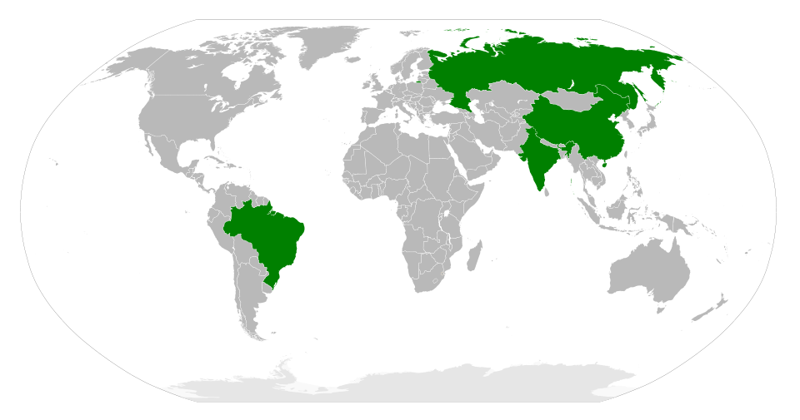
What is BRIC?
BRIC - Brazil, Russia, India and China.
The term was coined by Jim O'Neill of Goldman Sachs in a 2001 paper entitled "Building Better Global Economic BRICs". It was then prominently used in a Goldman Sachs report from 2003, which speculated that by 2050 these four economies would be wealthier than most of the current major economic powers.
Over 25% of the world’s land coverage
40% of the world’s population

Slide 12

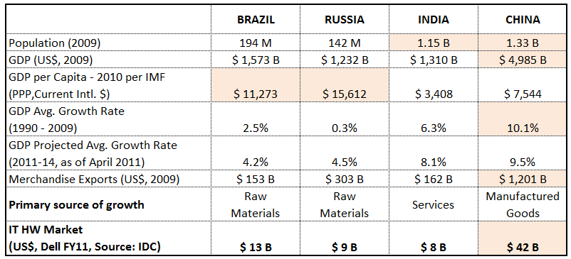
Comparison of BRIC Countries
Sources: www.globalsherpa.org, IDC, World data Bank, IMF, UNDP Human Development Report

Slide 13
Structure of IT market in BRIC countries
Source: IDC

Slide 14
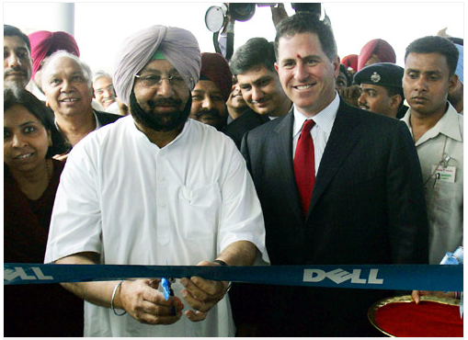
Dell in BRIC Countries

Slide 15
Dell in BRIC Countries: Brazil

Slide 16

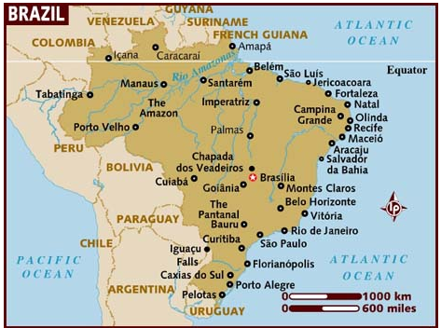
Brazil – IT Market Overview
Relatively high share of direct business (LE 50%, Public 20%, CSMB 10%)
Two large national retailers dominate the retail channel
B2B distributors – two tiers, 10 major distributors and fragmented re-sellers
Tax credits for local production
Highest Consumer segment share from BRIC countries – 61%
Strong local IT vendor Positivo - #1 in Consumer segment
Source: IDC

Slide 17
Brazil – Dell Approach
Initial Foundation 1999 - 2005
Invested in local production facility ahead of competition (1999)
tax/duty cost advantage
First to establish a large-scale direct model
generated tax advantage (avoid 10% transactional taxes)
Directly targeted foreign multi-national companies to establish on the market
first gained access with Servers, then high-price band PC’s with strong support proposition
Outcompeted on support and service
first to offer business customers on-site and next business day support across the entire re-seller base
Focus on cities in business-heavy South / South-East (50% population / 75% GDP)
Investment For Growth 2005 - 2009
New factory built in 2007
Shift to grow SMB segment (both Client and Servers, in Client focus on high and mid price bands)
Increased use of Channel partners to grow Public, local enterprises and SMB

Slide 18


Brazil – Dell Approach
Further Expansion 2009 – 2011
Push in Consumer segment via direct model
Geographical expansion to North / North-East
Increase of Services attach rate, esp. in Large Enterprise segment
Focus on mid-range Storage
Results of Dell Approach
Maintaining # 1 in Public/Enterprise PC business, both Desktops and Notebooks
Number 1 in Servers since FY07 to FY 11 >30% market share
Large opportunity for growth in Consumer segment (61% of market), Dell #4 in NB & #11 in DT

Slide 19
Dell in BRIC Countries: China

Slide 20
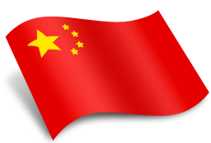
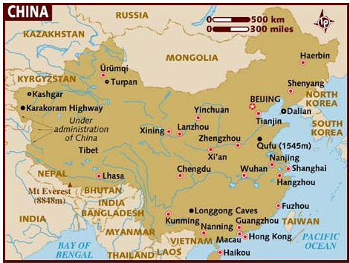
China – IT Market Overview
Relatively low share of direct business (LE 20%, Public 10%, CSMB 10%)
Fragmented retailers – large retailers control only ~ 20% of retail channel
B2B distributors – consolidated, two tiers with only 2 major distributors
Tax incentives for local production, import duties on commodities (~ 12%)
PC market dominated by Lenovo, in all customer segments
Source: IDC

Slide 21
China – Dell Approach
Initial Foundation 1999 - 2003
Built local manufacturing in 1998, matching competitors
tax/duty cost advantage
Direct model acted as an enabler of success
increased brand strength by differentiation
Initially targeted foreign multi-national companies, then moved to Chinese int’l / public companies
avoided government-funded, people-oriented, or domestic businesses
focused on Servers & Storage, competing with HP/IBM on price
Presence in all 45 tier 1-3 cities, but no smaller cities (40% market)
Investment For Growth 2003 - 2007
Senior leadership team investment to foster government / national Large Enterprise relationships
Focus on support service coverage prior to direct sales coverage
Outcompeted on support through greater coverage and enterprise support above industry standard levels
Shifted Consumer and SMB segments to 65% indirect model
Further investment in local manufacturing (2006)

Slide 22

China – Dell Approach
Further Expansion 2007 - 2011
Focused on improving Server after-sales support and service attach rates
Geographical expansion - built sales/services coverage via partners in ~900 tier 4-6 cities
Focus on building direct infrastructure to serve tier 1-3 cities
Built partnership with SMB and Educational segment focused Channel partners
Results of Dell Approach
Gained # 2 position in Consumer PC business, after the dominant Lenovo
Doubling Server market share since 2001 (from ~10% to ~20%)
Difficult competition in PC business due to the dominant position of Lenovo
Opportunities in Public/Enterprise PC business (#3-4), Servers (#3) and Storage (#3)

Slide 23
Dell in BRIC Countries: India

Slide 24
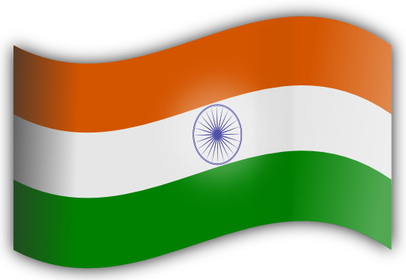
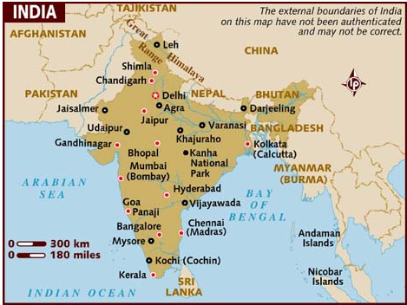
India – IT Market Overview
Relatively high share of direct business (LE 60%, Public 30%, CSMB 5%)
Fragmented retail channel – large retailers control <10% of retail channel
B2B distributors – most complex structure of BRIC countries, three tiers
Import duties (~ 10%)
Lowest Consumer segment share from BRIC countries – 38%
Source: IDC

Slide 25
India – Dell Approach
Initial Foundation 1999 - 2003
Directly targeted foreign multi-national companies, leveraging global relationship
focused on Servers and high & mid-price band PC’s
Focused on smaller cities to avoid pricing pressure of largest markets
Directly contracted with 35 Tier 2 (local) distributors; distributors given credit and regional exclusivity
Investment For Growth 2003 - 2007
Investment in local assembly in 2007 matched key competitors and enabled:
reduce taxes & duties and thus match competitor cost position
significantly reduce lead times from 4-5 weeks to <10 days
online sales
Extended onsite support service in 650 cities to retail and SB customers
Grow direct model
Focus on Consumer & SMB segments (from 10% Dell revenue to 60%)

Slide 26
India – Dell Approach
Expansion of Consumer 2007 - 2011
Opened 38 Dell retail stores in 2008
Grow online sales
Allowed distributors to sell at “Dell Direct” online price and still get margin
Results of Dell Approach
Rapid market share growth in Client (PC) business since 2008
Number 1 in Public/Enterprise PC business, both Desktops and Notebooks
Number 1 in Consumer Notebooks (#2 in Desktops after HP)
Opportunities for growth in Severs (#3) and Storage (#4)

Slide 27
Dell in BRIC Countries: Russia

Slide 28


Russia – the next big challenge

Slide 29
Russia’s Weaknesses
Macroeconomic weaknesses
High dependence on oil and natural gas: exports, fiscal revenues, growth
Lack of long-term savings, high dependence on foreign credit
Fiscal and political risks in the election year 2012

Slide 30
Russia’s Weaknesses
Institutional weaknesses
Political system dependent on single person (President), under-developed rule of law
High corruption
Preferred state-owned Russian-centric companies
Increasing involvement of state in the economy
Poor ranking in international surveys (ease of doing business, economic freedom, global competitiveness, corruption perceptions etc.)

Slide 31

Russia’s dependence on oil drives unpredictability in IT market
Note: IT market includes services and SnP in addition to PC/SV/ST
Source: IDC Black Book, Energy Information Administration

Slide 32
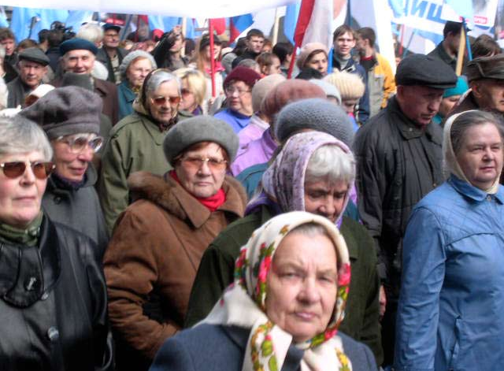
IT talent shortage in Russia will be exacerbated by demographic trends
Source: Federal Statistics Service

Slide 33
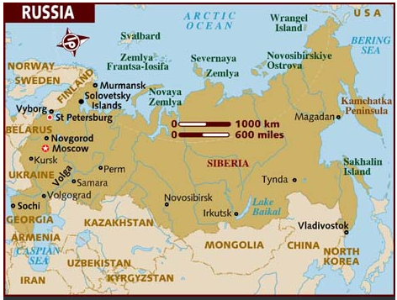
Russia – IT Market Overview
Very weak direct business (Public + LE <5%, CSMB <10%)
Five federal retailers control ~ 40% of the retail channel
B2B distributors – consolidated, two tiers with 5 major distributors
Import duties under consideration (~ 10%)
Dell not well established yet, very low market share
Source: IDC

Slide 34
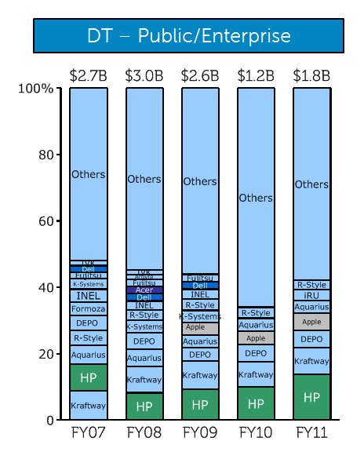
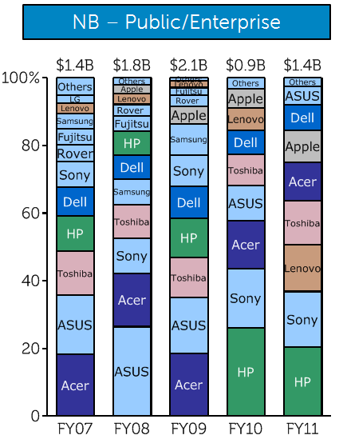
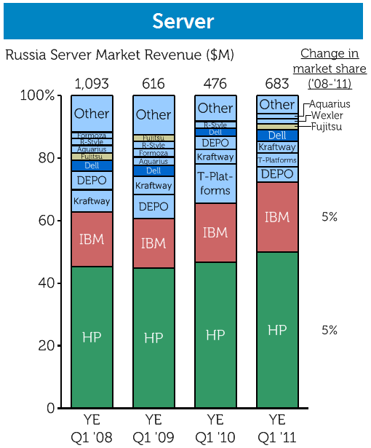
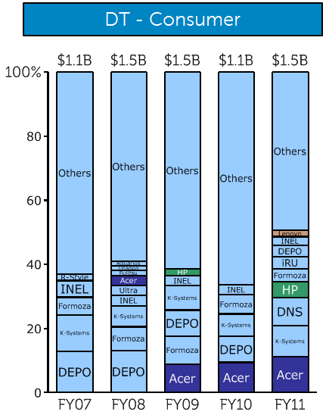
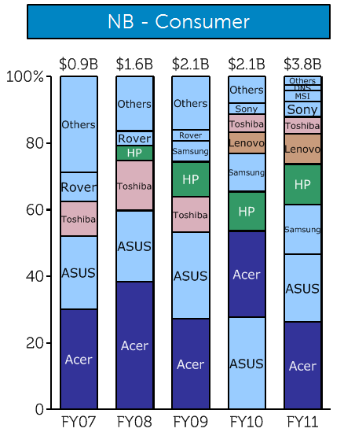
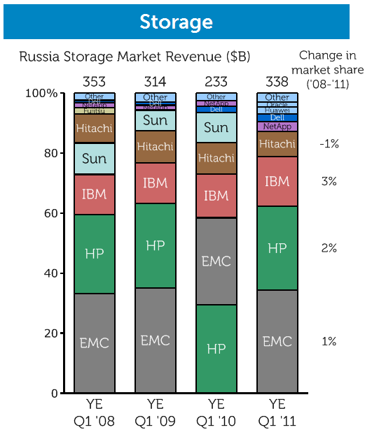
Dell’s market presence is extremely low across all customer segments / products
Source: IDC (FY00-11)

Slide 35
Class activity

Slide 36


Class Activity
Create teams of 4-5 students
Task 1
Based on Dell approach in Brazil, China and India, summarize key elements of successful IT market penetration in BRIC countries
Task 2
Brainstorm on key elements that will enable Dell penetrate successfully the Russian IT market in the future. Use the learnings from Brazil, China and India, and add any factors specific to Russia

Slide 37
Summary: Brazil, India, China model for success
Action | Evidence
Pursue client profitably, even in markets where focus is enterprise | Client is minimum 63% of revenues, even in markets where Enterprise is stated focus
Maintain strong focus on indirect business, even when pursuing direct model | ~45-60% of revenues in India and China from channel (Brazil 20%)
Develop local assembly to: Avoid import duty; Capture tax incentives; Improve supply chain | Estimated reduction of ~10% in cost, and 75% reduction in lead times
Adapt business practices to take advantage of local tax structure, e.g., direct billing | 5-20% reduction in cost in India and Brazil
Drive initial market entry through international MNCs before targeting local PLE | Entry strategy in Brazil, India and China focused on MNCs

Slide 38

Key takeaways
BRIC countries and other emerging markets are playing an increasing role in the global economy
The high GDP growth generates middle class and increased domestic consumption
BRIC countries and emerging markets represent a great opportunity for every global company and cannot be ignored
Every country is different and requires a specific business approach
In spite of relatively successful stories in India, Brazil and China, Dell is facing a big challenge in the Russian IT market

Slide 39
Thank You

Slide 40
Back-up

Slide 41
Interesting web-pages
http://www.globalsherpa.org/bric-countries-brics
http://articles.economictimes.indiatimes.com/2013-04-01/news/38189328_1_indian-markets-investment-cycle-emerging-markets
http://is.jrc.ec.europa.eu/pages/documents/CS87_Feat_SIMON_et_al.pdf

Slide 42
Country Group Name | 2010 | 2011 | 2012 | 2013 | 2014 | 2015 | 2016 | 2017 | 2010-2017 avg
European Union | 2.055 | 1.594 | -0.207 | 0.492 | 1.534 | 1.914 | 2.021 | 2.055 | 1.4%
Advanced economies | 3.012 | 1.594 | 1.291 | 1.538 | 2.277 | 2.597 | 2.646 | 2.637 | 2.2%
Central and eastern Europe | 4.593 | 5.273 | 1.986 | 2.576 | 3.175 | 3.497 | 3.729 | 3.786 | 3.6%
Latin America | 6.152 | 4.514 | 3.174 | 3.892 | 4.053 | 4.01 | 3.979 | 3.974 | 4.2%
Commonwealth of Independent States | 4.807 | 4.859 | 4.001 | 4.104 | 4.179 | 4.157 | 4.191 | 4.136 | 4.3%
Emerging economies | 7.447 | 6.171 | 5.279 | 5.635 | 5.895 | 6.066 | 6.142 | 6.189 | 6.1%
Developing Asia | 9.513 | 7.762 | 6.671 | 7.199 | 7.478 | 7.618 | 7.665 | 7.683 | 7.7%
Source: IDC

Slide 43
声明：
所有的版权属于原有公司，文件均来自公开渠道
此文件仅供学习使用，任何人不得进行以此为商业目的的行为
如有疑问，请立即删除
学习世界五百强和咨询公司PPT课程请访问如下网站搜索：“司马懿”
百度传课：司马懿PPT学校
网易学堂：司马懿PPT学校
知乎： 司马懿PPT学校
访问地址
https://www.chuanke.com
访问地址
https://study.163.com
访问地址
https://www.zhiu.com

